Slide 1


ITM 540
Data Networks
The Network Layer
Layer 3
The IPv4 Header Fields and their uses
Professor: Carol Davids
Email: davids@iit.edu
Carol Davids © 2014

Slide 2
Reading Assignment
Forouzan :
Chapter 20: TOS, Fragmentation, Checksum HLEN, and Protocol Type header fields
Pp 583-603
Carol Davids © 2014

Slide 3

IPv4 related to other protocols
IPv4 is one of several network layer protocols
Others are IGMP, ICMP, ARP and RARP
We will study ICMP, ARP and IPv4 this semester
Carol Davids © 2014

Slide 4
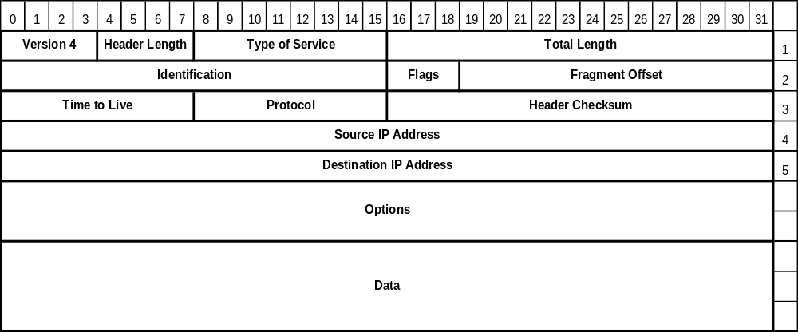
IP Protocol Datagram Format: top row
The fields in the top row of the IP datagram provide information about the datagram itself and the protocol that in encapsulates.
Carol Davids © 2014

Slide 5
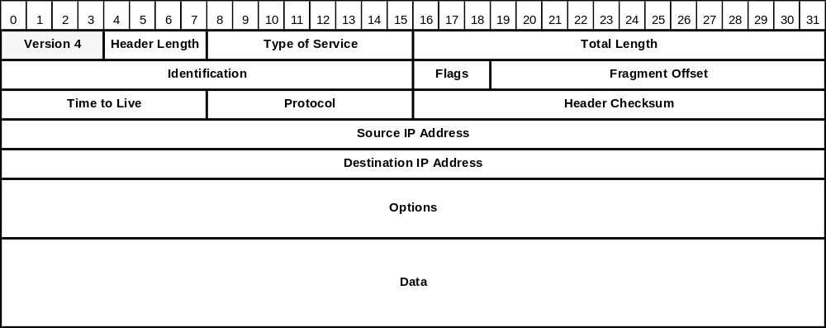
Version ( 4 bit field )
Indicates which version of the IP protocol was used to encode this datagram.
Enables the gradual adoption of new versions such as IP Version 6.
Carol Davids © 2014

Slide 6

Header Length ( 4 bit field)
The length of the header in 32-bit words
Its minimum value is 5: 5 words that are 4 bytes long = 20 bytes: The minimum header length is is 20 bytes.
Its maximum value is 15: 15 words that are 4 bytes long = 60 bytes: The maximum header length is 60 bytes.
Carol Davids © 2014

Slide 7
Example 1 of use of HLEN field:
If an IPv4 datagram arrives at a router with the first bytes as follows, what will the router do?
01000010…..
Answer: discard it
Why:
When the router parses the header it sees, 0100 = 4 for the version, that is good.
Then it reads 0010 = 2 for the HLEN. But the minimum value for HLEN is 0101 = 5, so the router discards the datagram.
Carol Davids © 2014

Slide 8
Example 2 of use of HLEN field:
If an IPv4 datagram arrives at a router with the first bytes as follows: How many options are carried in the packet?
01001000…..
Answer: The HLEN = 8, 4-byte words. The length without any options is 5, 4-byte words. So there are 3, 4-byte words that describe options. That is, 12 bytes of options
32 – 20 == 12
Carol Davids © 2014

Slide 9
Example use of HLEN plus total length
If an IPv4 datagram has HLEN = 5, and the total length field is 0x0028, how many bytes of data are carried in the datagram?
Answer:
The HLEN = 5 , so there is a 20 byte header;
Total length = 32 + 8 = 40 bytes (because 0x0028 == (2x16) + (8x1) )
40 - 20 = 20 bytes of data are carried in the datagram
Carol Davids © 2014

Slide 10
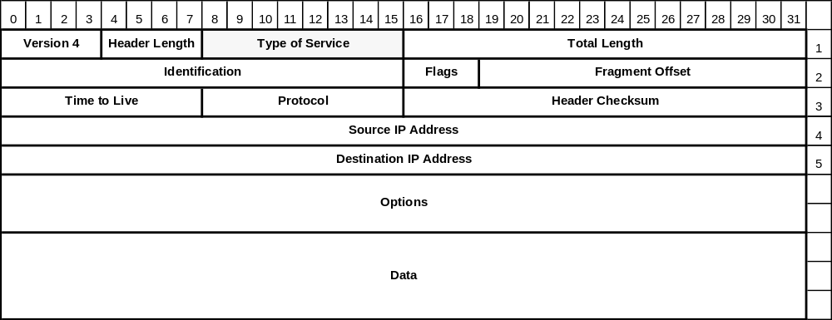
Type of Service (8 bits ) (TOS)
Distinguishes between different classes of service.
Classes of service can be defined by speed, reliability and priority.
Carol Davids © 2014

Slide 11
Type of Service (TOS)
This field has been changing in significance ever since it was created.
Many routers ignore this field entirely.
Today this field is used to support differentiated services.
Listing for current TOS values can be found at http://www.iana.org/assignments/ip-parameters.
The following describes the original use of the TOS bits.
Carol Davids © 2014

Slide 12

'Service Type' or 'Differentiated Services'
This field has been changing in significance ever since it was created.
The picture on the left shows how the 8 bits in the TOS field are used. 4 of them have significance.
The picture on the right shows how the 8 bits in the TOS field are used. 6 of them have significance.
Carol Davids © 2014

Slide 13
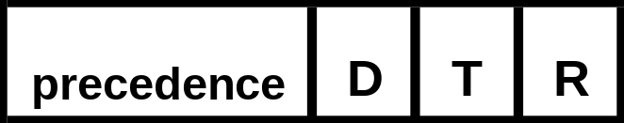
Type of Service
Originally consisted of a three-bit Precedence field followed by three flags leaving two unused bits.
Precedence field gave the priority of the datagram - from 0=normal to 7 = network control.
Flags indicated what was most important to maximize or minimize - delay, throughput or reliability.
Carol Davids © 2014

Slide 14
Type of Service
If the Delay bit is set - the system wants a path with minimum delay.
If the Throughput bit is set - the system wants a path with maximum throughput.
If the Reliability bit is set - the system want a path with minimum errors.
Carol Davids © 2014

Slide 15

Type of Service field - Service Type
Identifies to routers how to optimize the path for this particular packet. TOS field is 8 bits in length.
First 3 were not used
Of the next 4, only one may be set . Either
  minimize delay
  maximize throughput
  maximize reliability
  minimize monetary cost
The final bit is always set to zero
Carol Davids © 2014

Slide 16
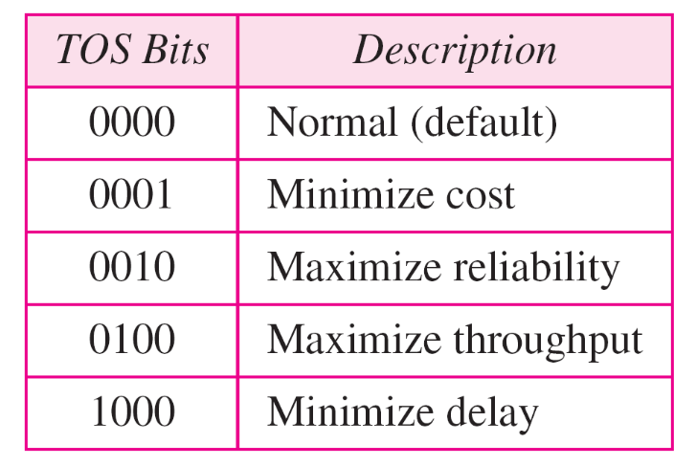
Type of Service field
TOS field interpretation
Notice we are using 4 bits but only 5 patterns
Carol Davids © 2014

Slide 17

Default types of service
Carol Davids © 2014

Slide 18
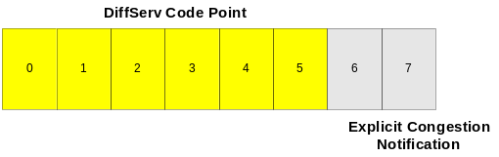
DiffServe and TOS Field
DiffServ is a method, specified in RFC 2475 and 3260 that enables one application to receive more bandwidth than another.
The method involves redefining the TOS bits in the IP header and using different values there to represent different classes of service.
Carol Davids © 2014

Slide 19
DiffServe and TOS Field
Within the network the DSCP (DiffServ Code Point) is used to determine the Per Hop Behavior of the IP datagram.
This means that routers in the network core need to be able to read the DSCP and take the appropriate action.
Look at the traces," cisco_OffToOn" and "skype" for examples of diffserve code point settings.
Carol Davids © 2014

Slide 20
Codepoints in diffserv field
Category 1 - codepoint xxxxx0 - Internet
Category 2 - codepoint xxxx11 - Local
Category 3 - codepoint xxxx01 - experimental
Carol Davids © 2014

Slide 21
Internet Protocol, Src Addr: 192.168.123.6 (192.168.123.6), Dst Addr: 192.168.123.1 (192.168.123.1)
Version: 4
Header length: 20 bytes
Differentiated Services Field: 0x68 (DSCP 0x1a: Assured Forwarding 31; ECN: 0x00)
Total Length: 52
Identification: 0x15fe (5630)
Flags: 0x00
Fragment offset: 0
Time to live: 64
Protocol: TCP (0x06)
Header checksum: 0xed05 (correct)
Source: 192.168.123.6 (192.168.123.6)
Destination: 192.168.123.1 (192.168.123.1)
Signaling data is carried using point code 0x68 which stands for Assured Forwarding
Carol Davids © 2014

Slide 22
Internet Protocol, Src Addr: 192.168.123.21 (192.168.123.21), Dst Addr: 192.168.123.3 (192.168.123.3)
Version: 4
Header length: 20 bytes
Differentiated Services Field: 0xb8 (DSCP 0x2e: Expedited Forwarding; ECN: 0x00)
Total Length: 200
Identification: 0x006b (107)
Flags: 0x00
Fragment offset: 0
Time to live: 254
Protocol: UDP (0x11)
Header checksum: 0x4398 (correct)
Source: 192.168.123.21 (192.168.123.21)
Destination: 192.168.123.3 (192.168.123.3)
RTP data is carried using point code 0x2e which stands for expedited forwarding
Carol Davids © 2014

Slide 23
Type of Service http://www.rhyshaden.com/qos.htm
Traditionally, IP Precedence has used the first three bits of the TOS field to give 8 possible precedence values.
000 (0) - Routine
001 (1) - Priority
010 (2) - Immediate
011 (3) - Flash
100 (4) - Flash Override
101 (5) - Critical
110 (6) - Internetwork Control
111 (7) - Network Control
Carol Davids © 2014

Slide 24
Type of Service http://www.rhyshaden.com/qos.htm
DiffServ introduces the concept of the DiffServ Code Point (DSCP) that uses the first 6 bits of the TOS field thereby giving 2⁶ = 64 different values.
RFC 2474 describes the Differentiated Services (DS) field and the DiffServ Code Point (DSCP).
Carol Davids © 2014

Slide 25
Assured Forwarding: RFC 2597
Abstract: “This document defines a general use Differentiated Services (DS) Per-Hop-Behavior (PHB) Group called Assured Forwarding (AF).
The AF PHB group provides delivery of IP packets in four independently forwarded AF classes.
Within each AF class, an IP packet can be assigned one of three different levels of drop precedence. …..”
Carol Davids © 2014

Slide 26
Expedited Forwarding: RFC 2598
Abstract:…This document describes a Per Hop Behavior (PHB) called Expedited Forwarding.
Can be produced by more than one mechanism
Can be used to produce at least one service, a Virtual Leased Line.
Carol Davids © 2014

Slide 27
Explicit Congestion Notification (ECN)
Last (lowest) 2 bits of the 8-bit TOS field
Use of this 2-bit field is specified in RFC 3168
Optional feature
Only used when both endpoints signal they want to use it
Currently supported values:
  ECN-unaware Transport
  ECN-aware Transport
  Congestion Experienced
Requires the support of the Transport Layer process
Carol Davids © 2014

Slide 28

Total Length (16 bit field )
Length in bytes of the entire datagram - header and body. Header length + body length == total length
Current upper limit is 2¹⁶ or 65536. In the future, larger datagrams may be needed. (for gigabit networks)
Carol Davids © 2014

Slide 29

Fragmentation
The second row of the IP header is dedicated to fragmentation
Fragmentation is the process of breaking up the IP datagram into packets no larger than the Maximum Transfer Unit length of the particular LAN/WAN that must be traversed
Carol Davids © 2014

Slide 30
Fragmentation
Remember that Ethernet’s MTU is 1500 bytes
That is, Ethernet II cannot carry any payload larger than 1500 bytes long
Ethernet wraps the network layer datagram in a 14 byte header and a 4 byte trailer
Carol Davids © 2014

Slide 31
Fragmentation on entering an Ethernet II LAN
The total length of the layer two frame must be less than or equal to 1518 bytes
The total length of the body of the layer two frame must be less than or equal to 1500 bytes
That means, the total length of the IP datagram carried inside the Frame must be less than or equal to 1500 bytes.
Carol Davids © 2014

Slide 32

Maximum Transfer Units
Examples of different WAN/LAN protocols and their MTUs
Carol Davids © 2014

Slide 33
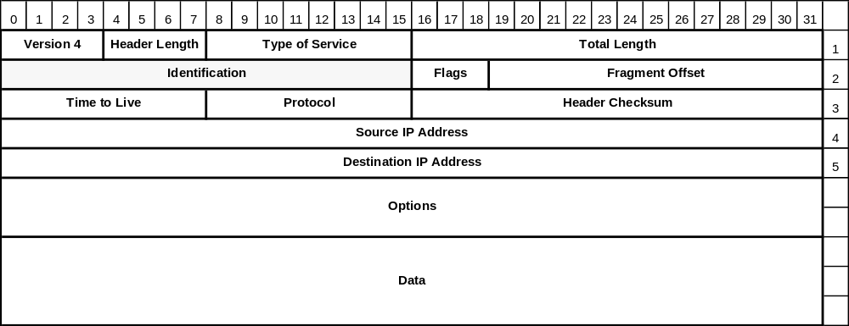
Identification (16 bit field )
Tells the receiving host which datagram this fragment belongs to.
All fragments of a datagram have the same Identification value.
Carol Davids © 2014

Slide 34
Flags (3 bit field - each bit is one flag)
First bit is unused.
Second bit is the DF bit - Don’t Fragment.
Third bit is the MF bit - More Fragments
Carol Davids © 2014

Slide 35

Detail on flags used for fragmentation
If the ‘do not fragment’ bit is set, then it is necessary to either discard the datagram or to send it un-fragmented
If the ‘more fragments’ bit is sent, then the datagram must be reassembled before being sent up to layer 4.
Carol Davids © 2014

Slide 36
Don’t Fragment
Tells the router not to fragment the datagram because the receiving system cannot put the fragments back together.
A datagram marked DF may be routed around small-packet networks, even though those networks might provide a quicker or less costly route.
Example of use: When a computer boots, its ROM may ask for a memory image to be sent in a single datagram
Carol Davids © 2014

Slide 37
More Fragments
Tells the receiving system that it has not gotten all the pieces of the datagram yet.
All fragments except the final fragment have the MF bit set.
Carol Davids © 2014

Slide 38
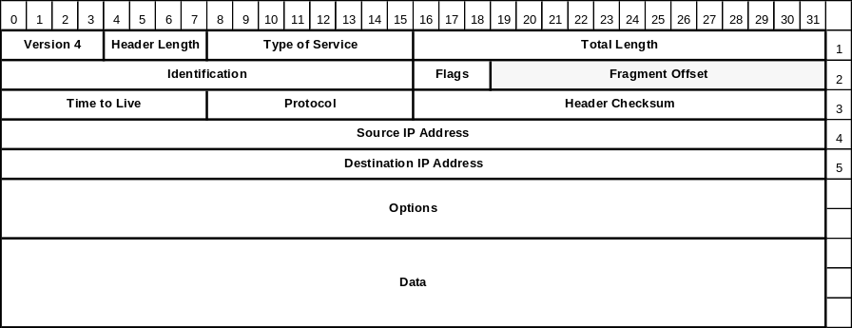
Fragment Offset (13 bit field )
Tells the receiving host where in the datagram this fragment belongs.( Helpful in case two fragments took different paths and the later one was received earlier.)
All fragment offsets except the last one must be a multiple of 8 bytes.
Carol Davids © 2014

Slide 39
Fragment Offset (13 bit field )
The shortest allowed fragment unit is 8 bytes long.
All fragments but the last fragment must be at least 8 bytes long.
All fragments but the last fragment must be multiples of 8 bytes in length
Since the field that identifies the fragment is 13 bits long, it is possible to identify 2¹³ different fragments.
That is, there can be up to 8,192 fragments to a datagram.
Carol Davids © 2014

Slide 40

Example 2
The original datagram is 4000 bytes long. It is divided into three fragments. The first fragment is 1400 bytes long. The second is also 1400 bytes long. The last is 1200 bytes long.
Carol Davids © 2014

Slide 41
Example 2
The original datagram is 4000 bytes long. It is divided into three fragments. The first fragment is 1400 bytes long. The second is also 1400 bytes long. The last is 1200 bytes long.
More fragments flag is set
Fragment offset = 0
More fragments flag is set
Fragment offset = 2800/8 = 350
More fragments flag is set
Fragment offset = 1400/8 = 175
Carol Davids © 2014

Slide 42

example 3
In this example, Fragment 2 is fragmented again.
Carol Davids © 2014

Slide 43
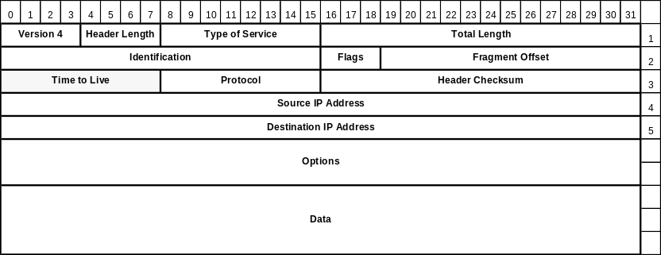
Time To Live (8 bit field )
This field is a counter. It is used to limit the number of routers a datagram may pass through.
It was designed to have units of seconds.
We use it to count “hops”, where each router is one hop.
Carol Davids © 2014

Slide 44
Time To Live (8 bit field )
Each router that handles the packet decreases the value in this field by 1.
When the counter reaches the value 0, the packet is discarded and a warning message is sent back to the source host.
The warning message is sent in an ICMP datagram. ICMP is the management protocol associated with the IP protocol.
Carol Davids © 2014

Slide 45
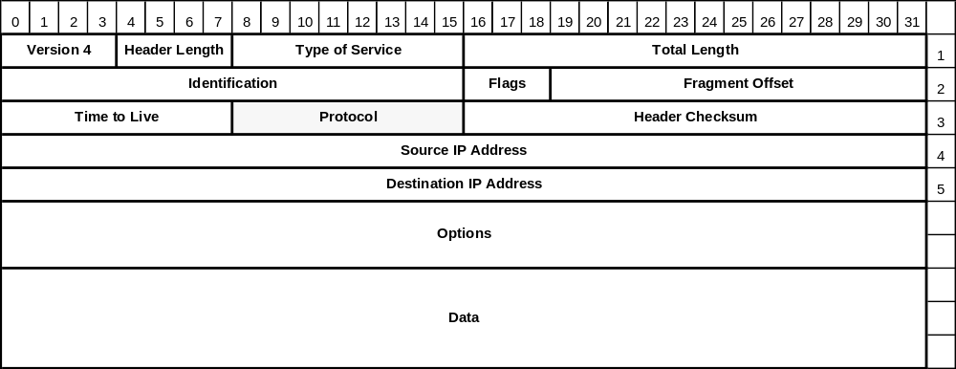
Protocol (8 bit field )
The protocol field tells the network layer where to deliver the datagram.
That is, which layer 4 process needs to receive this datagram.
Carol Davids © 2014

Slide 46
Protocol (8 bit field )
Possible layer 4 processes include UDP, encoded as 17, and TCP, encoded as 6.
These encodings are industry standard.
The current list can be found on-line at IANA’s web site http://www.iana.org/numbers.html
IANA is the Internet Assigned Numbers Authority.
Go to this document to learn the values that can be placed in the protocol field of an IP datagram: http://www.iana.org/assignments/protocol-numbers/protocol-numbers.xml
Carol Davids © 2014

Slide 47
Protocol (8 bit field )
More examples of protocols that can be used as a layer 4, transport layer, carried in the body of an IP datagram:
HIP, the Host Identity Protocol is 139
SCTP, the Streaming Control Transport Protocol is 132
MPLS in IP is 137
PIPE, Private IP Encapsulation within IP, is 131
Carol Davids © 2014

Slide 48
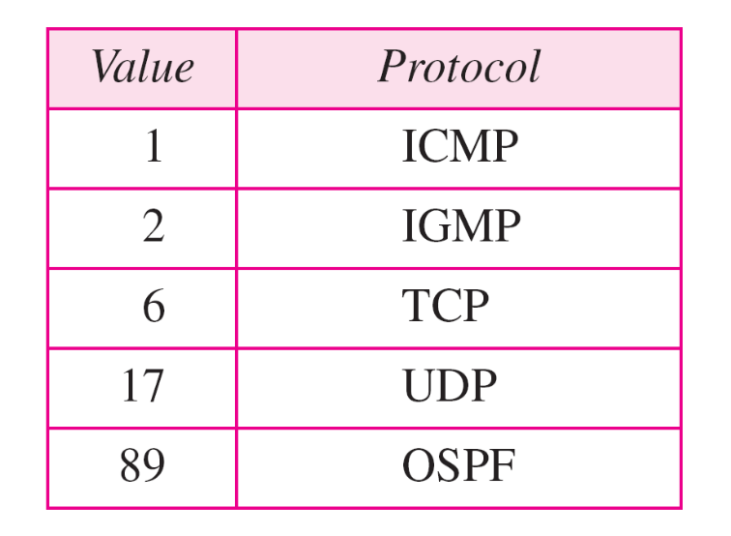
Values for Protocol Types
Carol Davids © 2014

Slide 49

Header Checksum (16 bit field )
The header checksum only verifies the header bits.
It is designed to detect bad memory words in the router.
Carol Davids © 2014
Notes:
Icmp
header 8 bytes

Slide 50
Header Checksum (16 bit field )
Each router needs to recalculate the checksum because at least one field changes with each hop - the TTL.
Carol Davids © 2014
Notes:
Ping is utility that generate echo request

Slide 51
Header Checksum (16 bit field )
  Sender sets the checksum value to 0.
    Adds up all the 16 bit half words
    Takes the 1’s complement of the result.
    Puts this value into the Checksum field
  The receiver adds up all the 16 bit words.
    Takes the 1’s complement of the result
    If answer is not 0, the datagram is discarded
  Refer to Section 10.5, Forouzan, ed.4
Carol Davids © 2014
Notes:
4500
0350
0a45
00a0
8001
16c5 check sum field
0a00
0103
0a00
0101

Slide 52

Example header checksum
Taking the 1’s complement:
7 = 0111. Its 1’s complement is 1000, which is 0x8 (hex 8)
4 = 0100. Its 1’s complement is 1011, which is 0xB (hex B)
Carol Davids © 2014

Slide 53
Reference
http://www.netfor2.com/checksum.html
http://en.wikipedia.org/wiki/Ones'_complement
Carol Davids © 2014

Slide 54
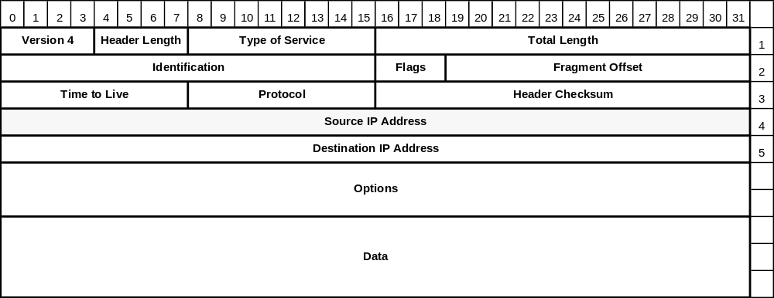
Source IP Address (32 bit field )
Indicates the IP address of the source of the datagram.
The 32 bit field allows us to identify over 4 billion (4.294967296 * 10**9) addresses.
Carol Davids © 2014
Notes:
Xxxxxxxx xxxxxxxx xxxxxxxx xxxxxxxx

Slide 55
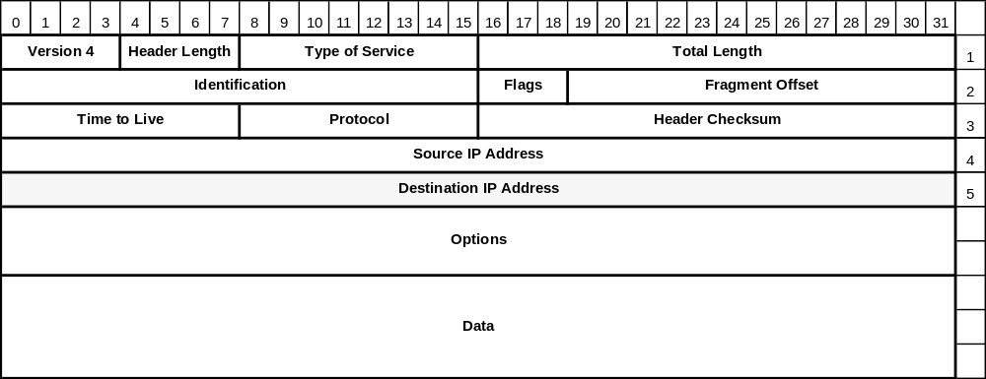
Destination IP Address (32 bit field )
Indicates the IP Address of the destination of the datagram.
The 32 bit field allows us to identify over 4 billion (4.294967296 * 10**9) addresses.
Carol Davids © 2014
Notes:
64 131 109 25
Dotted decimal representation of a 32bit binary value
2
16 – compact – easy to read , coefficient 계수
Decimal , 32 bit

Slide 56
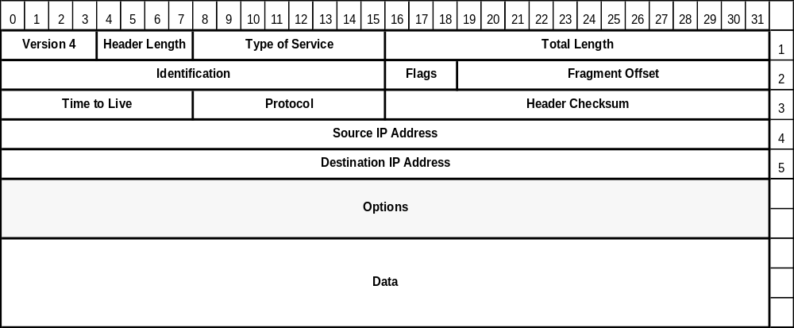
Options (varies )
The Options field serves to future-proof the IP protocol.
Carol Davids © 2014

Slide 57
Options (varies )
It allows experimenters to include information in the IP header that is not presently specified.
Designers can use this without burdening the specification with bits that will rarely be used.
Carol Davids © 2014

Slide 58
Options
An option can have variable length.
An option begins with a 1 byte code that identifies the option.
Following the option code there may be a length field telling how long the option is.
Following this optional length field is one or more data bytes.
The options field is always padded out to fill up 4 bytes – that is, one ‘line’ of the diagram, or one 4-byte word.
Carol Davids © 2014

Slide 59
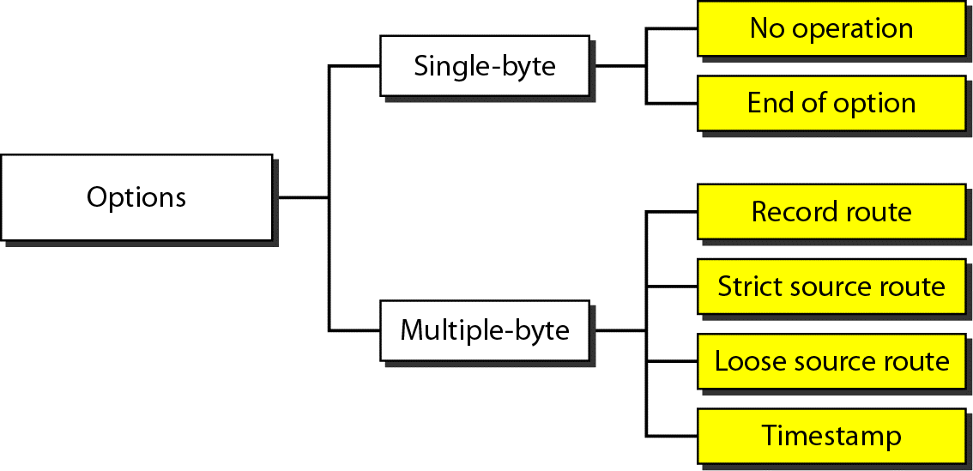
Taxonomy of options IPv4
This illustration helps understand the different possible options for IPv4.
Carol Davids © 2014

Slide 60
Options
The current complete list of Options is found at www.iana.org/assignments/ip-parameters.
We will look at 5 current options:
  Security
  Strict source routing
  Loose source routing
  Record route
  Timestamp
Carol Davids © 2014

Slide 61
Options
Security - Option Type 130
  Tells how sensitive the information is.
Carol Davids © 2014

Slide 62
Options
Strict Source Routing - Option Type 137
  Identifies the complete path from source to destination as a series of IP addresses
  The datagram must follow this exact route.
  Used by network managers to bypass routers with corrupted routing tables and also to make timing measurements
Carol Davids © 2014
Notes:
Must memorize

Slide 63
Options
Loose Source Routing - Option Type 131
  Identifies a list of routers through which the datagram must pass.
  The datagram may in addition pass through other routers.
  Used to force a packet to go in one general direction or another (Go east rather than west, for example.)
Carol Davids © 2014

Slide 64
Options
Record Route - Option Type 7
  Tells a router to add its IP address to the option field.
  Enables network managers to track problems in their routing tables.
Carol Davids © 2014

Slide 65
Options
Timestamp - Option Type 68
  Tells a router to add a 32-bit time stamp .
  Enables network managers to track problems in their routing algorithms.
Carol Davids © 2014

Slide 66
Wireshark Traces
  Frame 87 (87 bytes on wire, 87 bytes captured)
  Ethernet II, Src: 00:a0:c9:82:e8:16, Dst: 00:0b:46:cc:61:e1
  Destination: 00:0b:46:cc:61:e1 (216.47.140.2)
  Source: 00:a0:c9:82:e8:16 (Intel-Hf_82:e8:16)
  Type: IP (0x0800)
  Internet Protocol, Src Addr: 216.47.140.180 (216.47.140.180), Dst Addr: 192.168.123.254 (192.168.123.254)
  Version: 4
  Header length: 20 bytes
  Differentiated Services Field: 0x00 (DSCP 0x00: Default; ECN: 0x00)
  Total Length: 73
  Identification: 0xe2e8 (58088)
  Flags: 0x00
  Fragment offset: 0
  Time to live: 128
  Protocol: UDP (0x11)
  Header checksum: 0xb630 (correct)
  Source: 216.47.140.180 (216.47.140.180)
  Destination: 192.168.123.254 (192.168.123.254)
  User Datagram Protocol, Src Port: 3104 (3104), Dst Port: domain (53)
  Domain Name System (query)
Carol Davids © 2014

Slide 67
Wireshark Traces
  Internet Protocol, Src Addr: 216.47.140.180 (216.47.140.180), Dst Addr: 192.168.123.254 (192.168.123.254)
  Version: 4
  Header length: 20 bytes
  Differentiated Services Field: 0x00 (DSCP 0x00: Default; ECN: 0x00)
  Total Length: 73
  Identification: 0xe2e8 (58088)
  Flags: 0x00
  Fragment offset: 0
  Time to live: 128
  Protocol: UDP (0x11)
  Header checksum: 0xb630 (correct)
  Source: 216.47.140.180 (216.47.140.180)
  Destination: 192.168.123.254 (192.168.123.254)
Carol Davids © 2014

Slide 68
WiresharkTraces
What is the version of the IP protocol?
What is the length of the header?
What is value in the TOS field?
What is the length of the protocol data unit?
What is the ID of this fragment?
Is this datagram fragmented?
What protocol is carried in the body of this datagram?
What are the source and destination IP Addresses?
Carol Davids © 2014

Slide 69
The End
Carol Davids © 2014

Slide 70
Sending the Datagram
The first bit that is sent is the “high order” bit in the version field (the one labeled 0 in the drawing.)
This method of sending datagrams is called “Big Endian” .
Carol Davids © 2014

Slide 71
Sending the Datagram
It is important that the receiving system uses this same method - or that it translate if it uses the other “Little Endian” method.
  SPARC systems are big endian
  Pentiums are little endian.
  Software conversion is necessary on both transmit and receive sides.
Carol Davids © 2014

Slide 72
Fragmentation
IP receives a message from layer 4
IP determines that the message needs to be fragmented.
IP fragments the message.
IP adds a header to each fragment before handing the three separate protocol data units down to layer 2.
Segment 1
Segment 2
Segment 3
Carol Davids © 2014

Slide 73
Fragmentation
IP adds a header to each fragment before handing the three separate protocol data units down to layer 2.
Header 1
Segment 1
Header 2
Segment 2
Header 3
Segment 3
Carol Davids © 2014

Slide 74
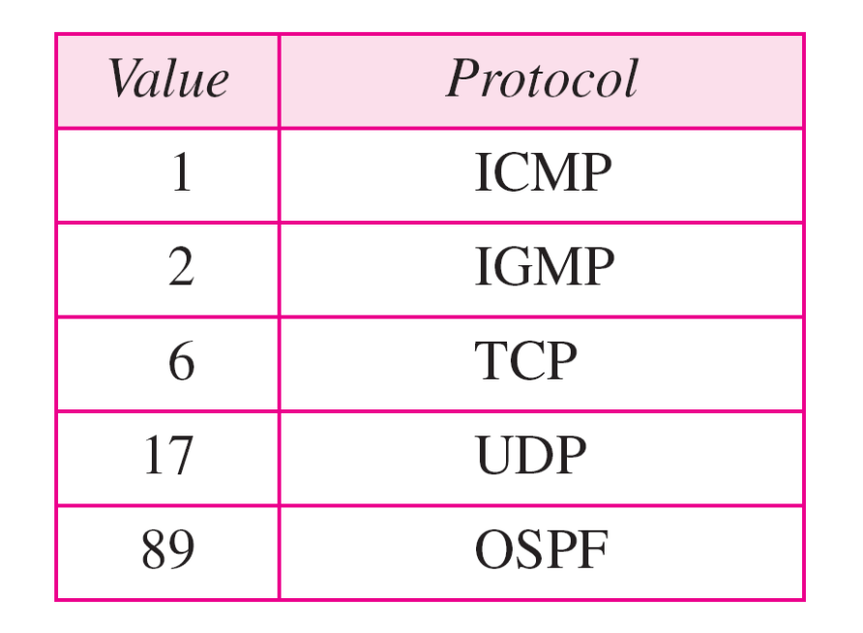
Values of Protocol Type
Carol Davids © 2014

